Slide 1
Clauses and Sentences
Types | Definitions | Examples

Slide 2
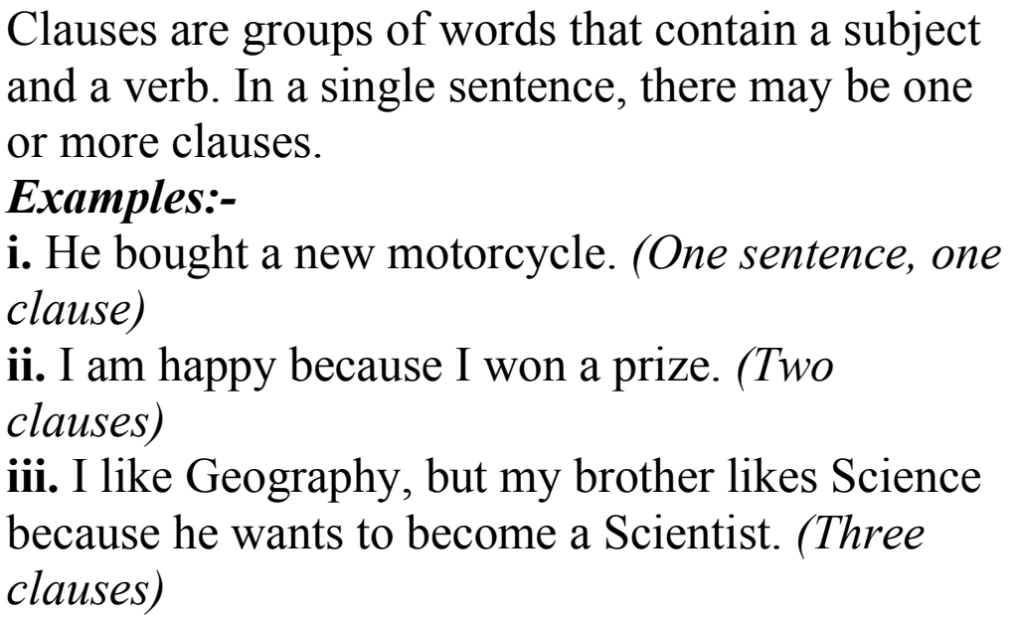

Slide 3
Types of clauses
Principal/ Independent
Clause
Subordinate/
Dependent
Clause
Coordinate
Clause

Slide 4
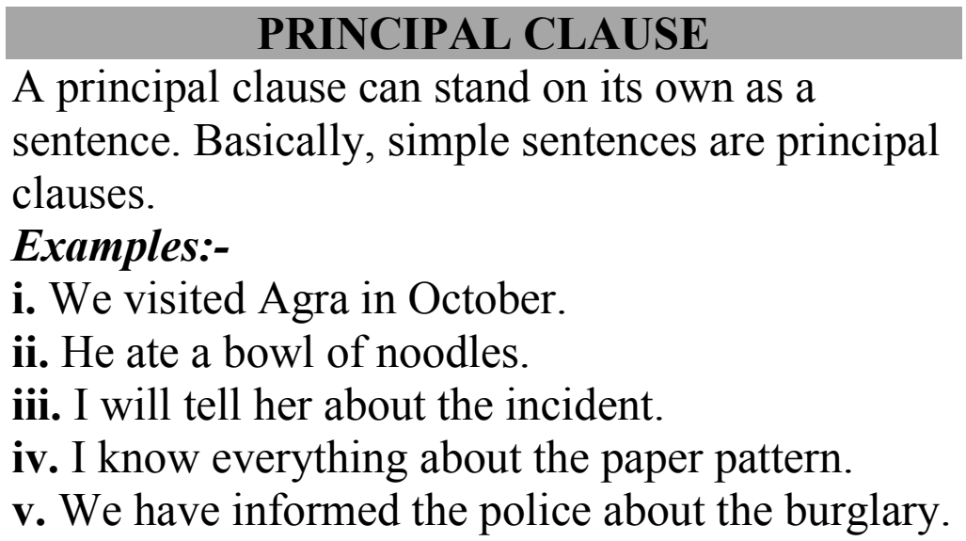

Slide 5
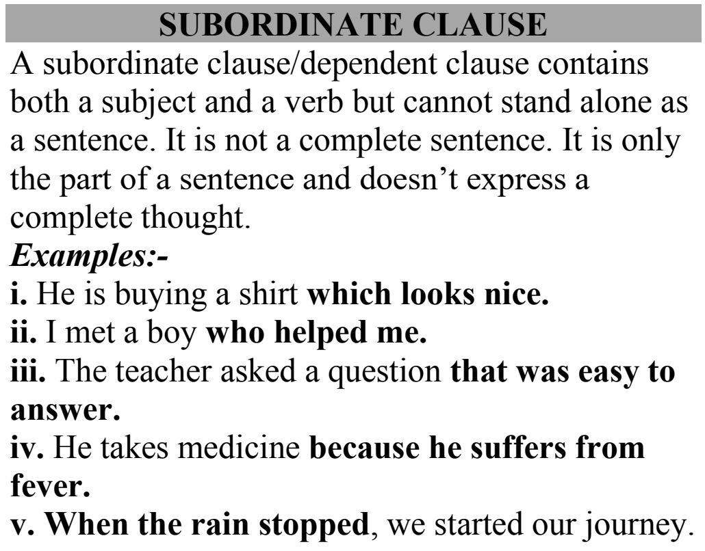

Slide 6
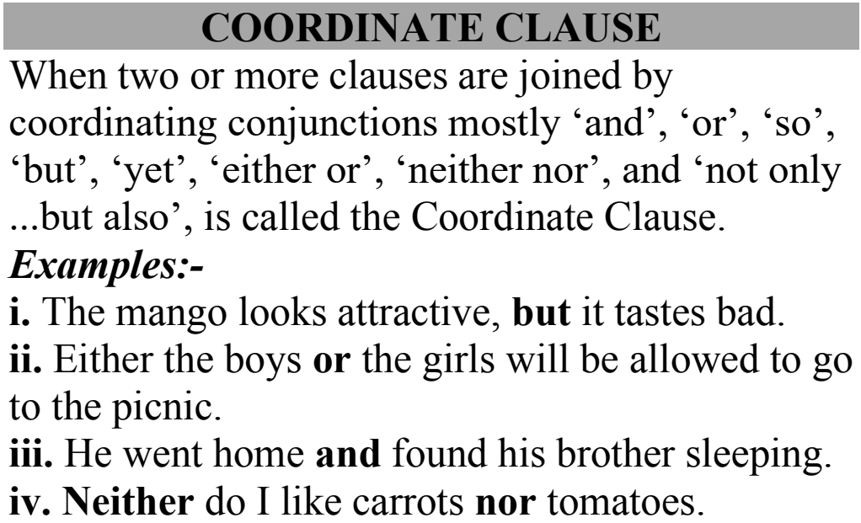

Slide 7
Types of Subordinate clause
Noun Clause
Adjective or Relative Clause
Adverb Clause

Slide 8
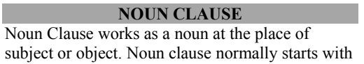
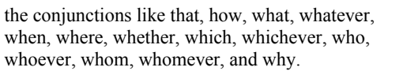
Noun Clause

Slide 9
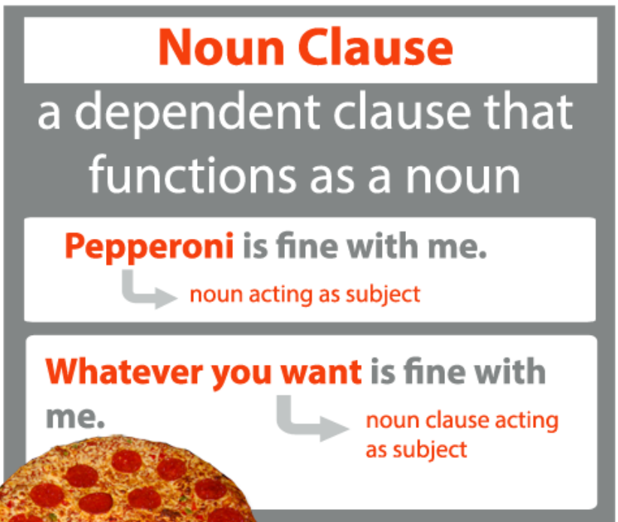
Noun clauses are when the subordinate clause in the sentence replaces a noun. Noun clauses contain both a subject and a verb, and typically function as direct objects or predicate nominatives.

Slide 10
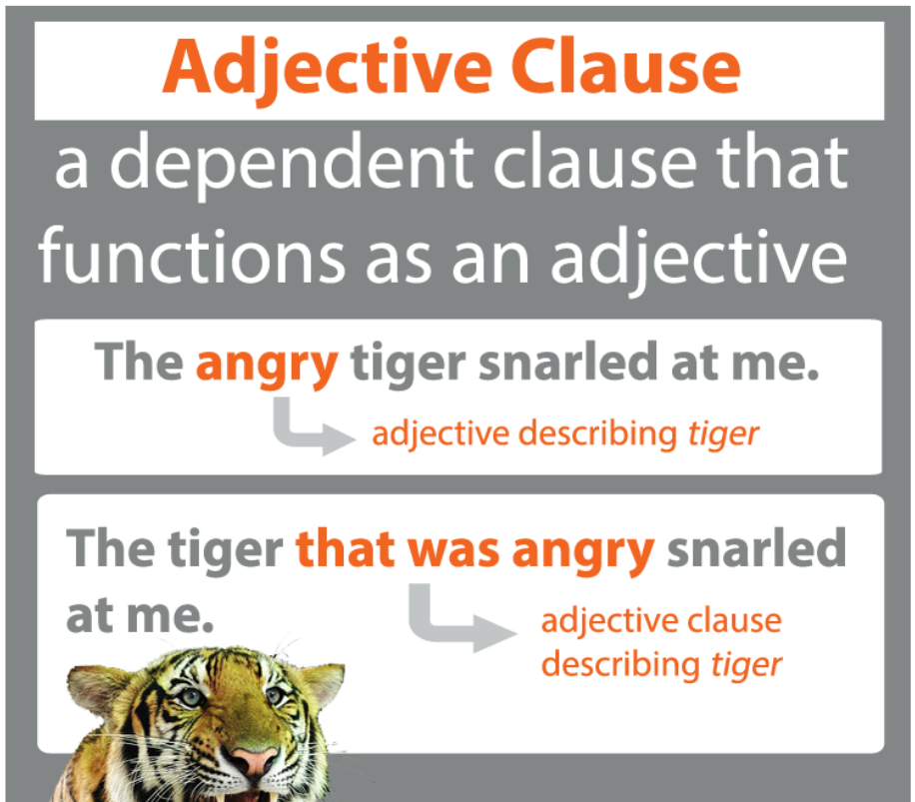

Slide 11
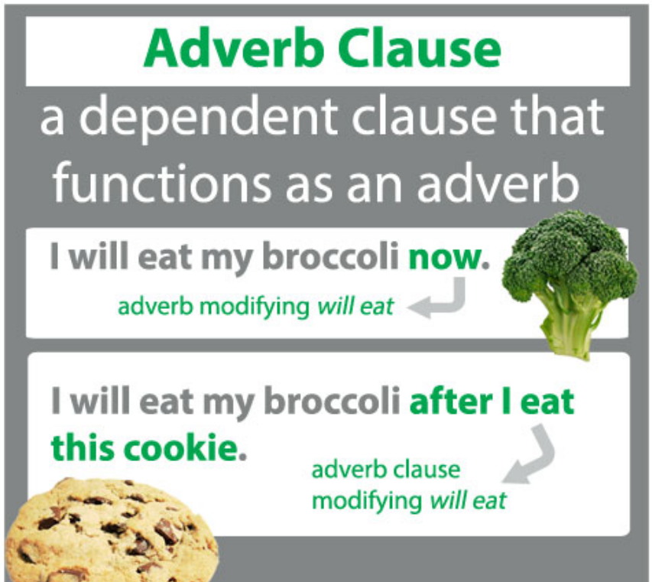

Slide 12
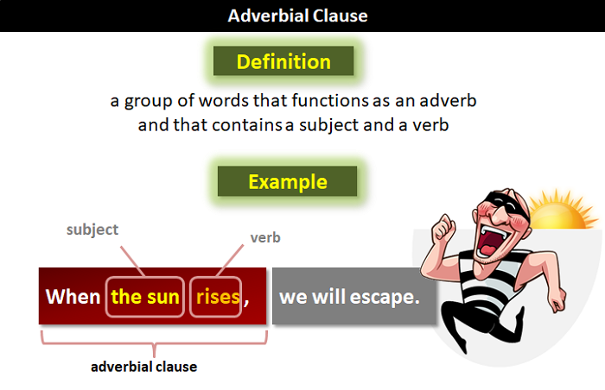

Slide 13
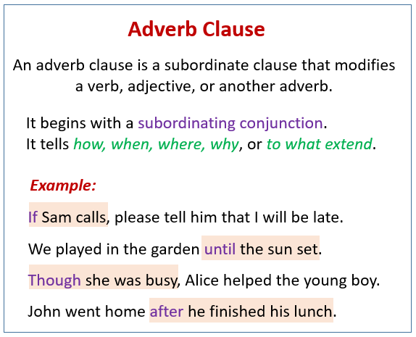

Slide 14
Subordinate Clause | Coordinate Clause
A Subordinate Clause is a clause that would make no sense if it was taken out of the sentence. | A Coordinate clause is a clause that has meaning independent of the sentence.
For Example – He took out a book that he had seen earlier. | For example – The rain ended and the sun came out.
The subordinate clause is “that he had seen earlier” makes no sense by itself. It must be a part of a larger sentence. | “The rain ended” and “The sun came out” both have meaning by themselves.

Slide 15
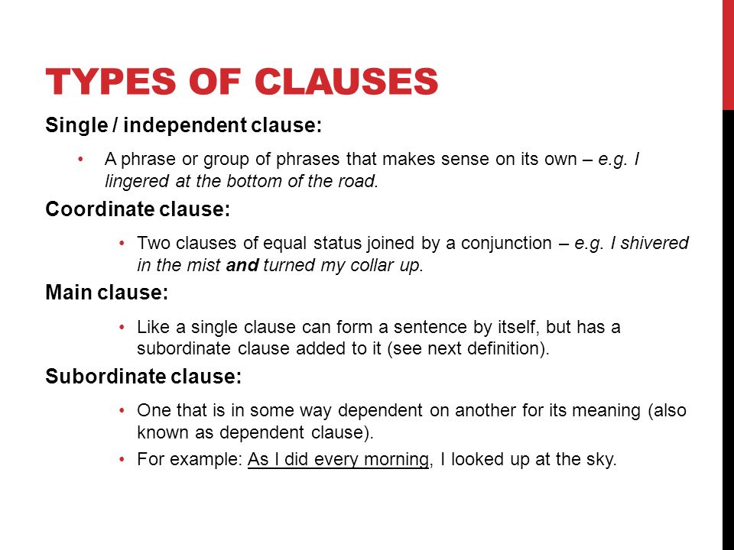

Slide 16
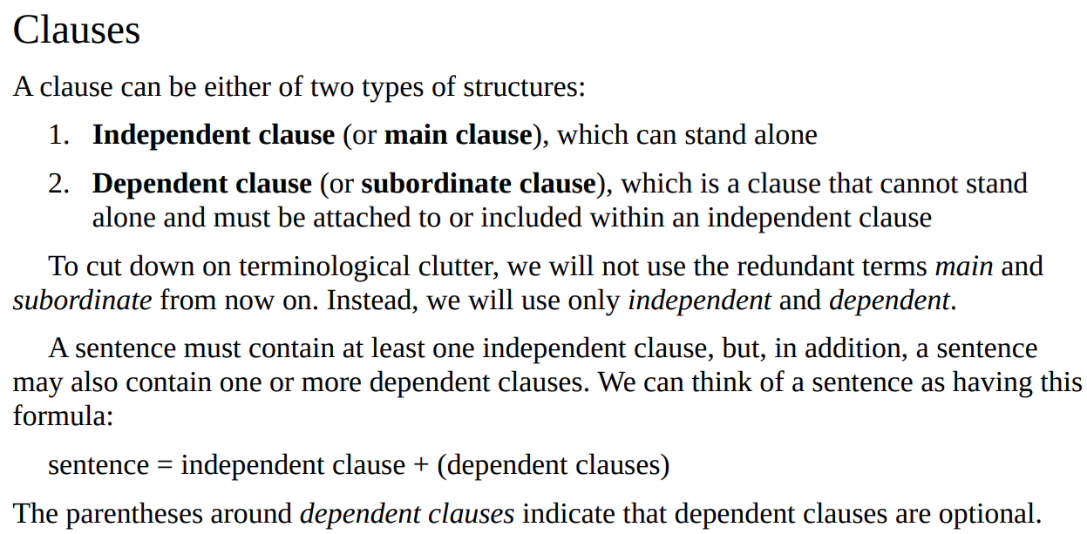

Slide 17
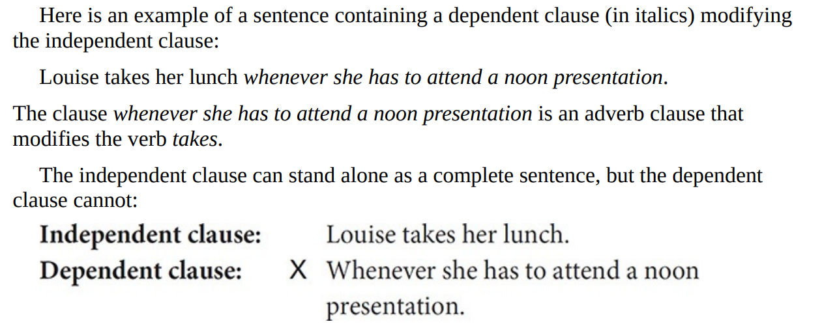

Slide 18
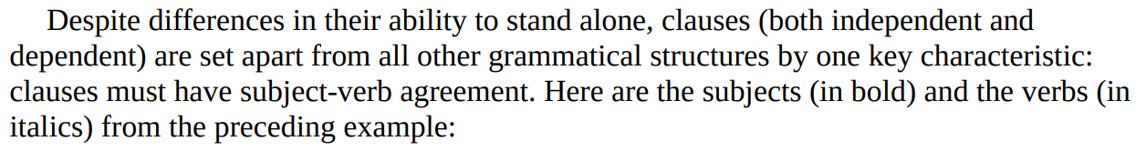
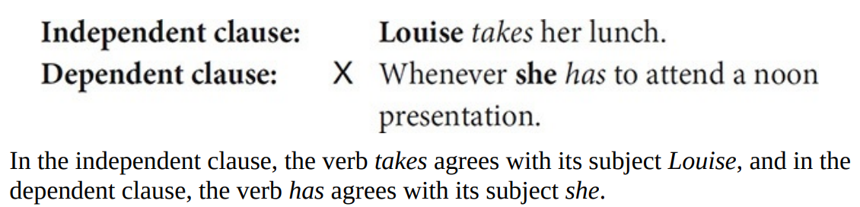

Slide 19
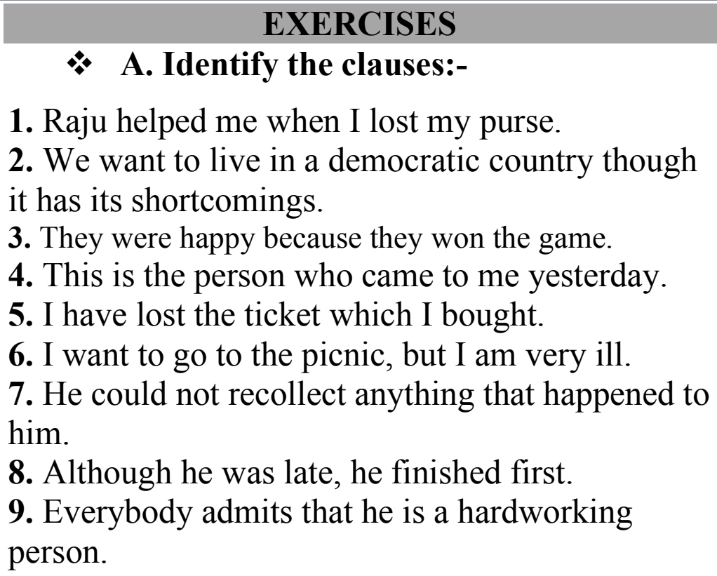

Slide 20
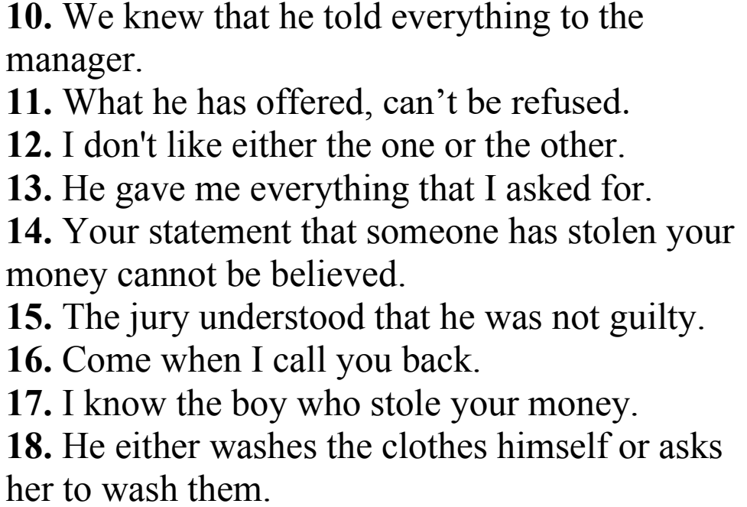

Slide 21
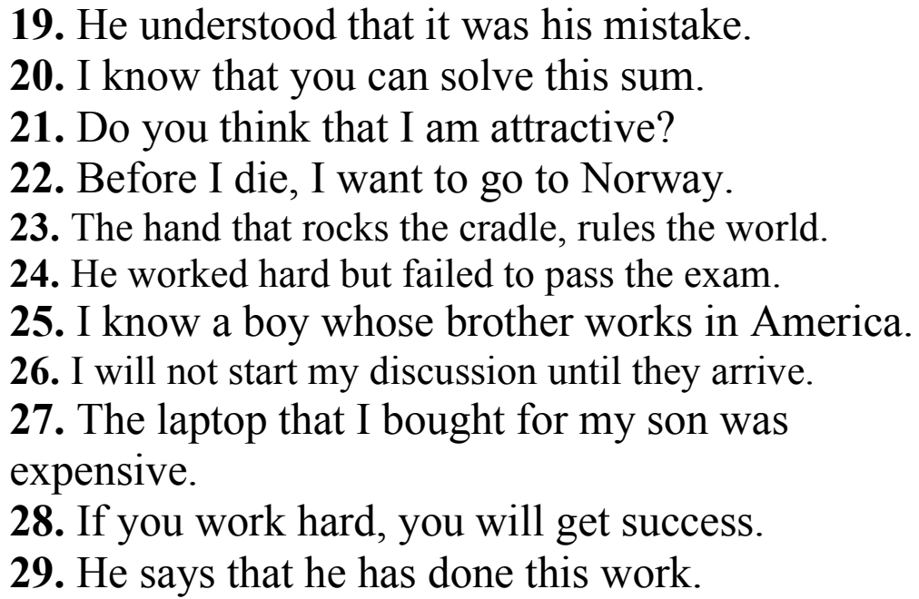
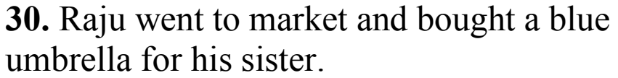

Slide 22
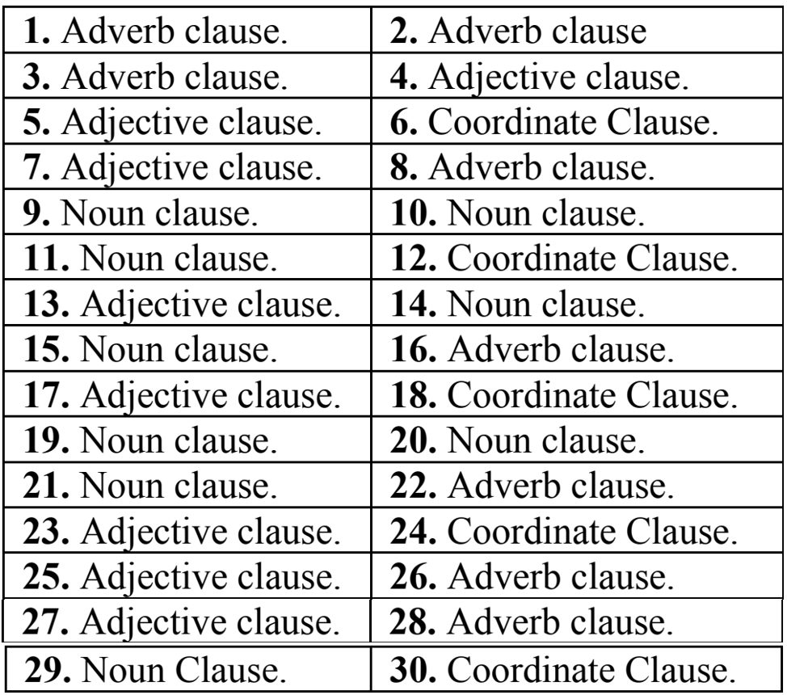
Answers

Slide 23
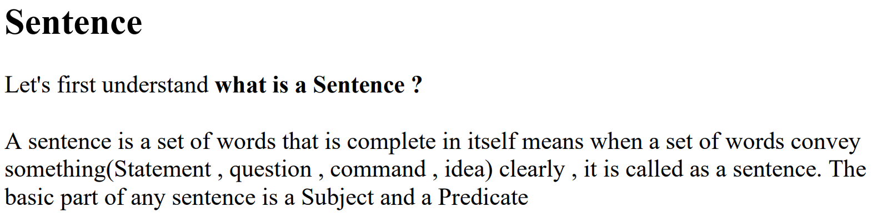
Sentences

Slide 24
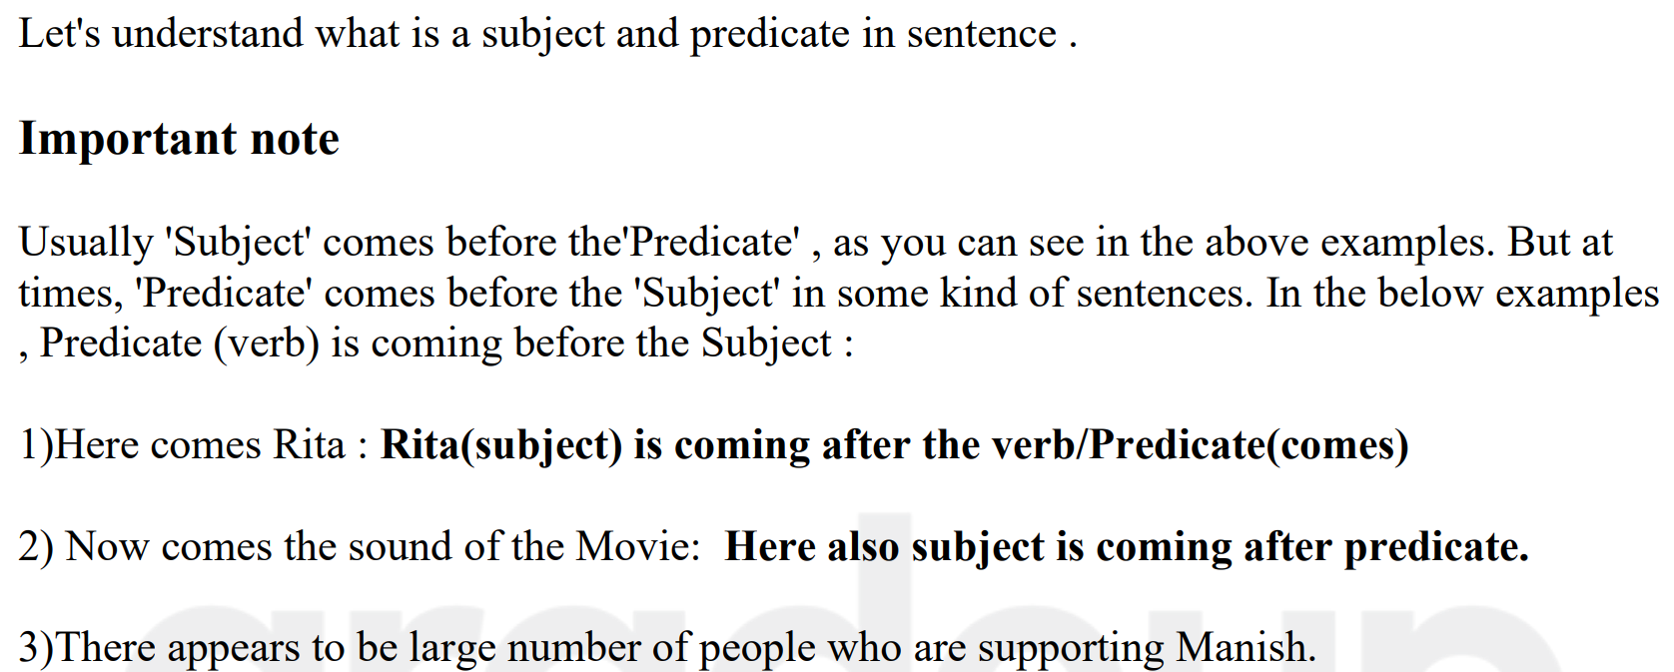

Slide 25
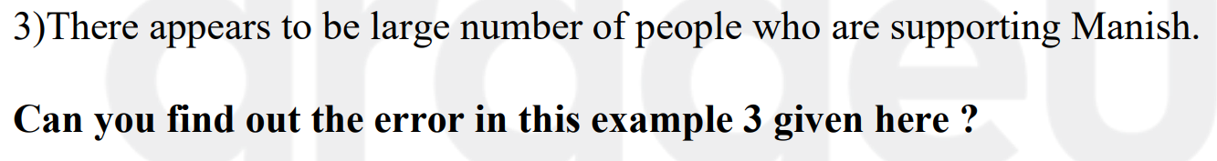
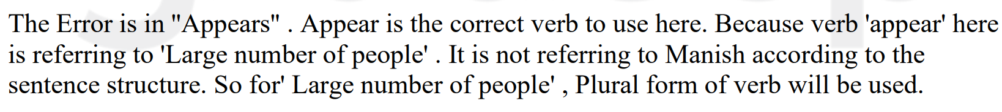

Slide 26
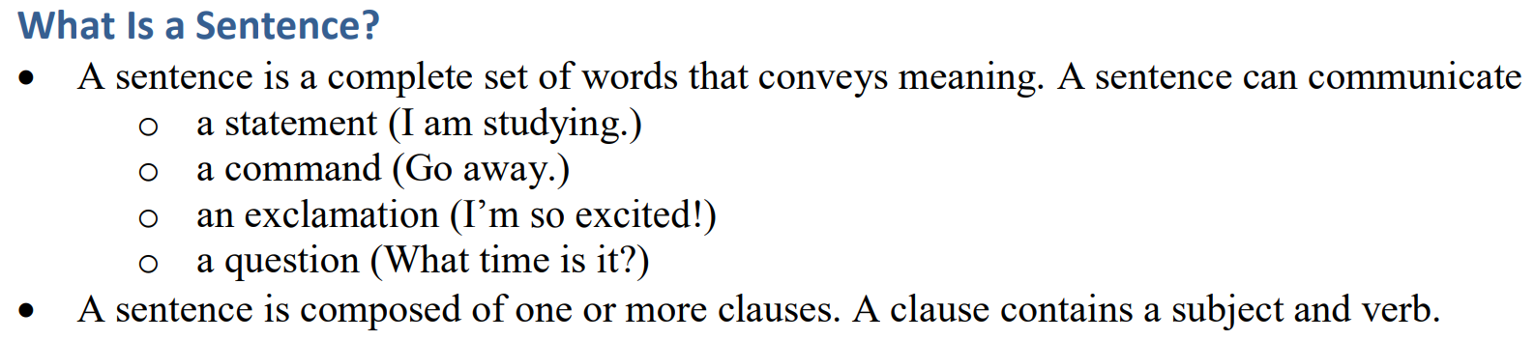

Slide 27
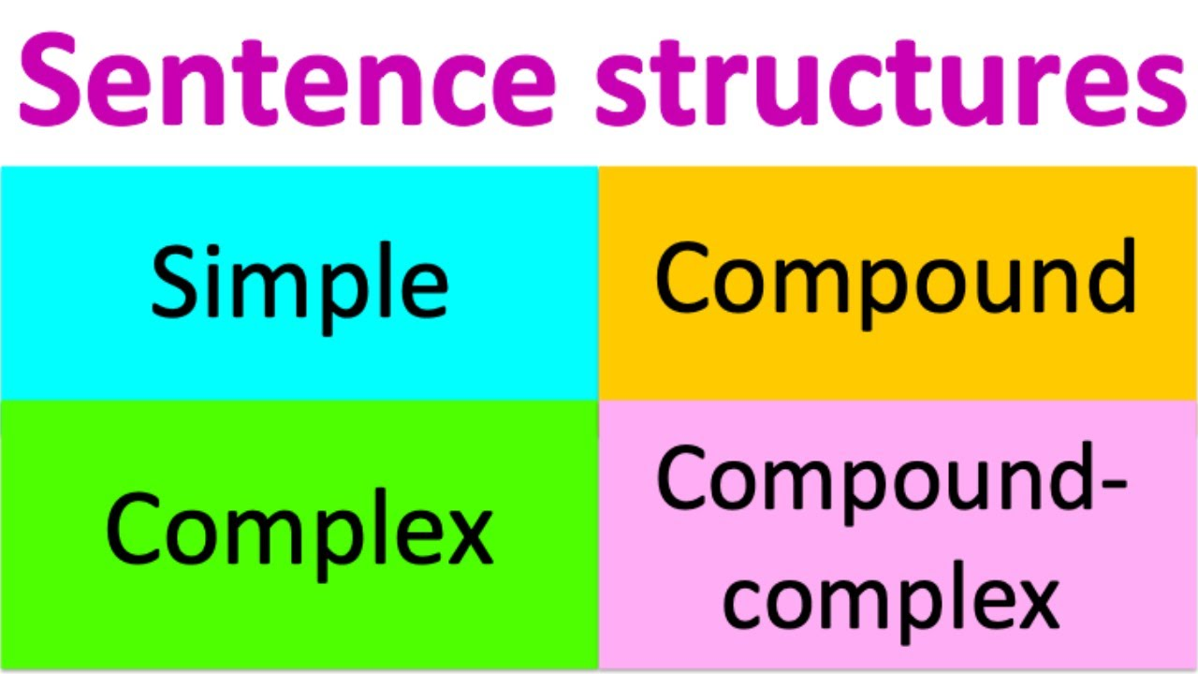

Slide 28
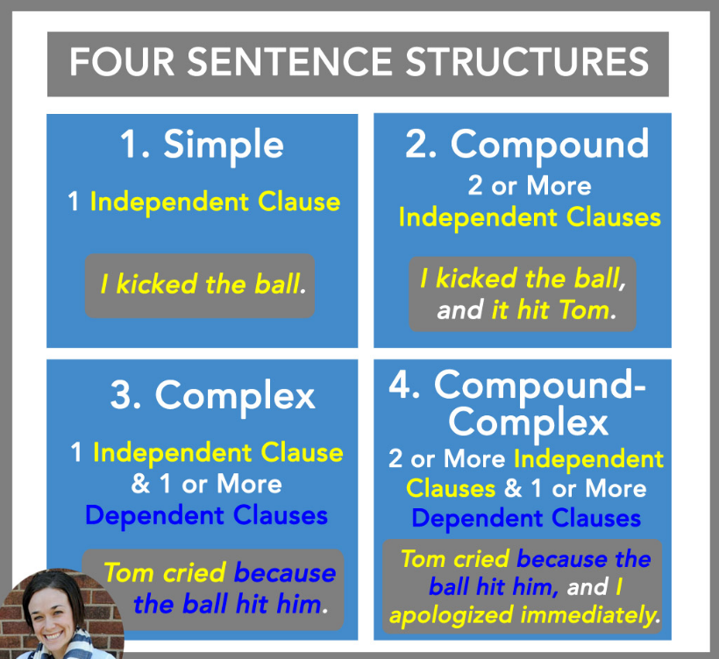

Slide 29
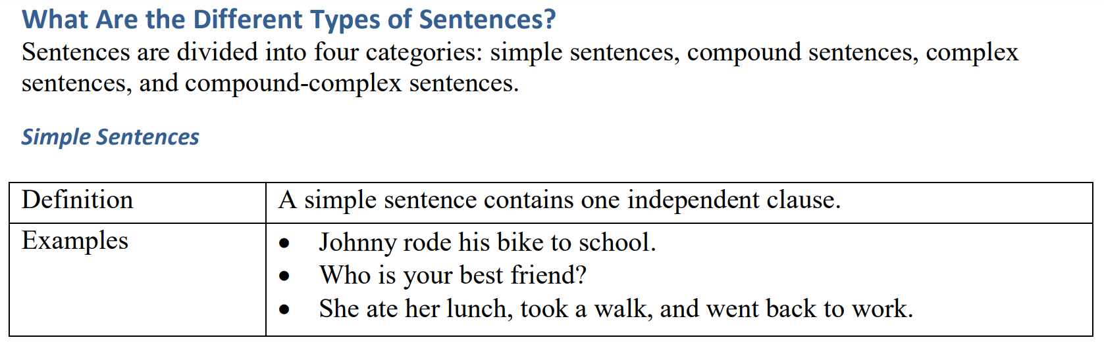

Slide 30
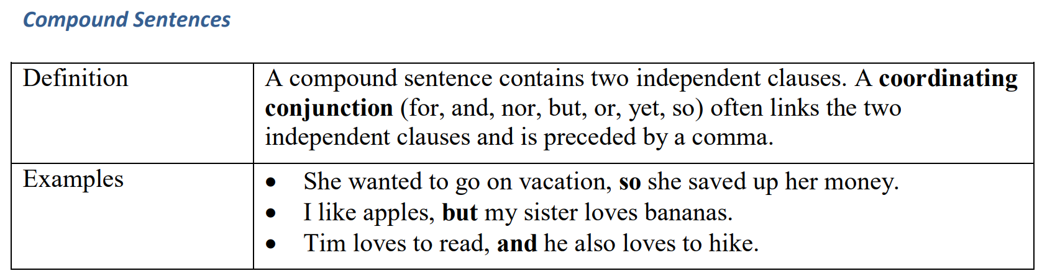
Compound Sentences

Slide 31
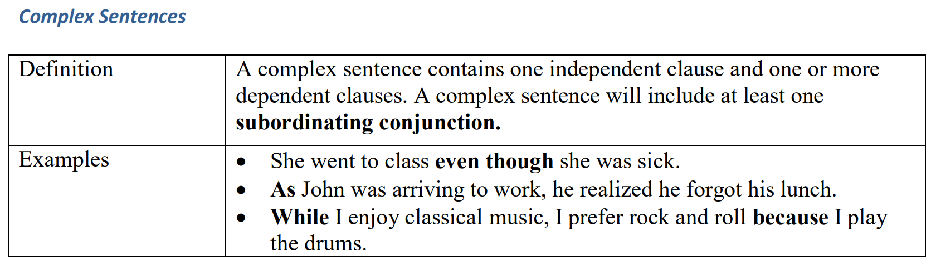
Complex Sentences

Slide 32
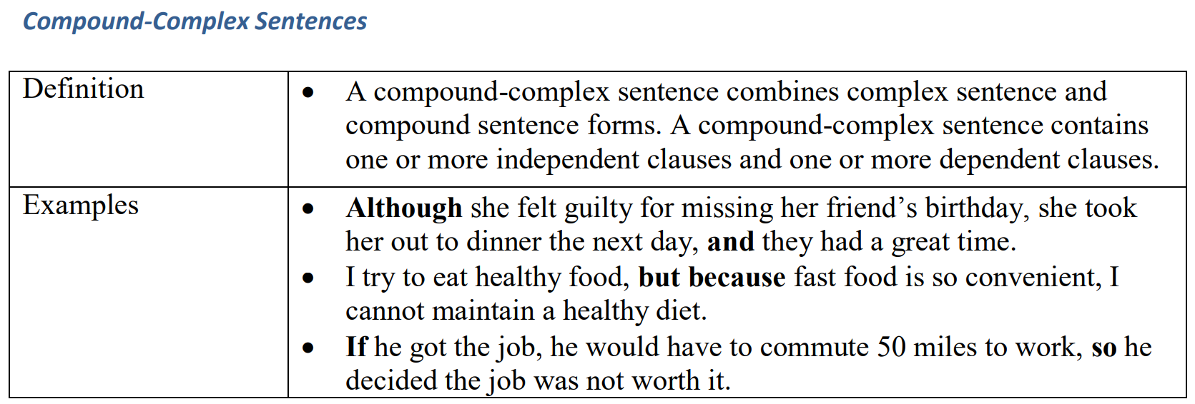
Compound Complex Sentences

Slide 33
4 Kinds of Sentences
Declarative
Imperative
Interrogative
Exclamatory

Slide 34
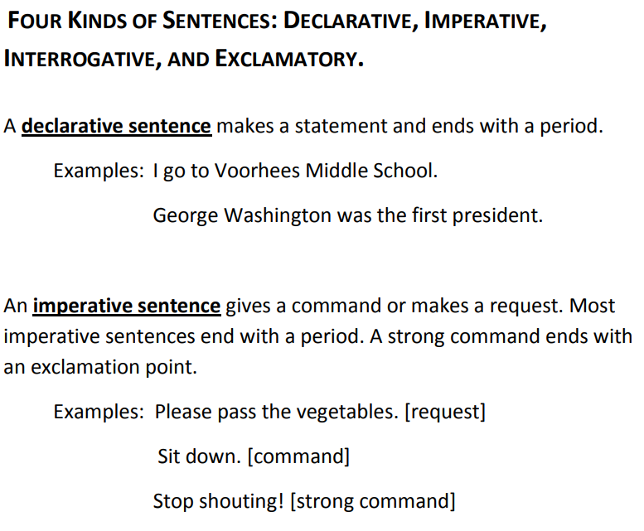

Slide 35
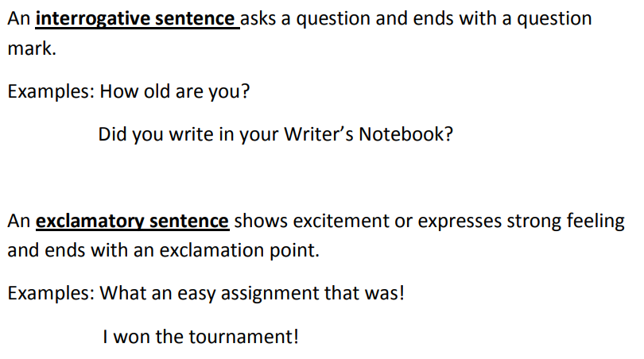

Slide 36
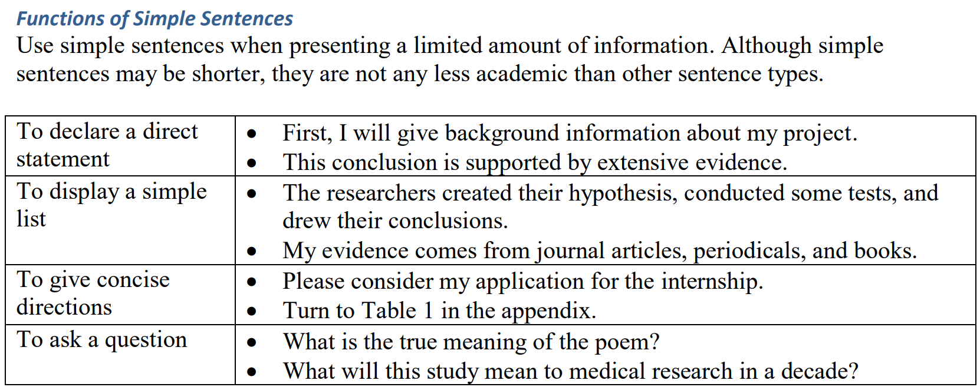

Slide 37
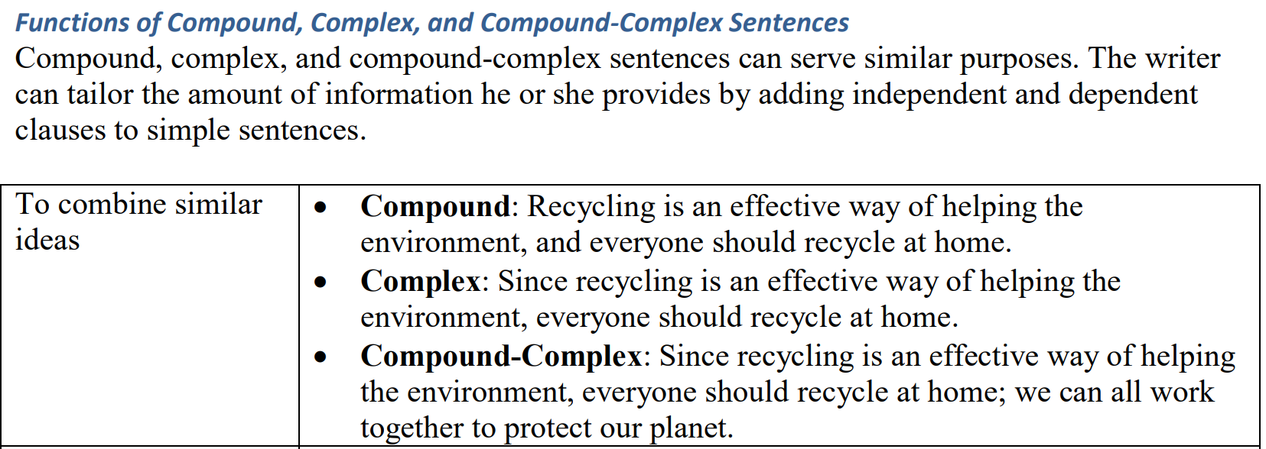

Slide 38
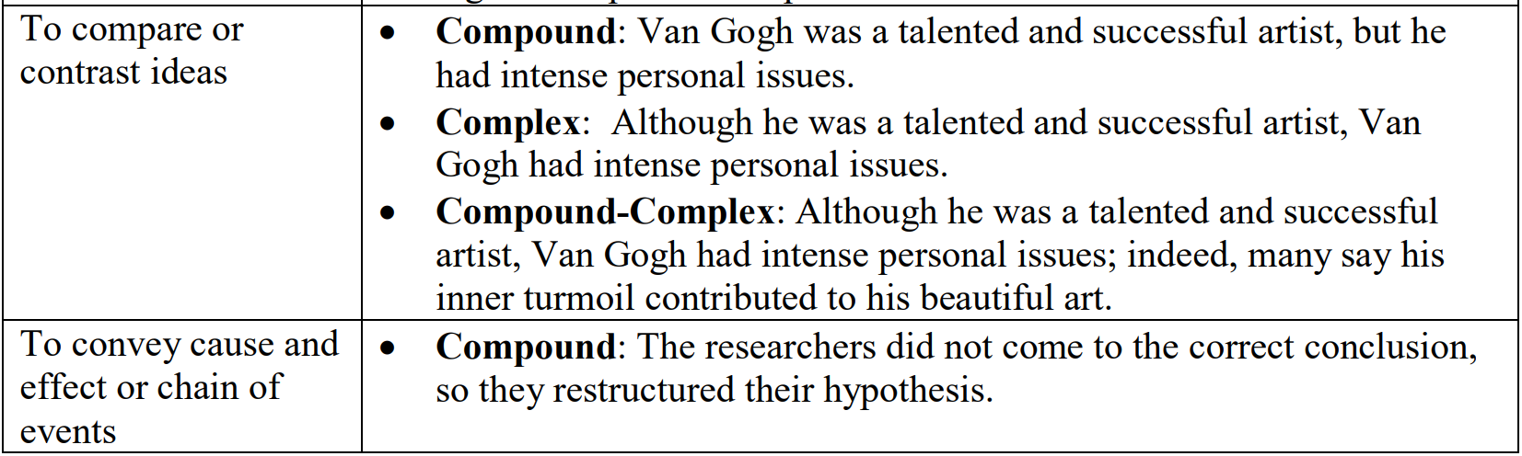

Slide 39
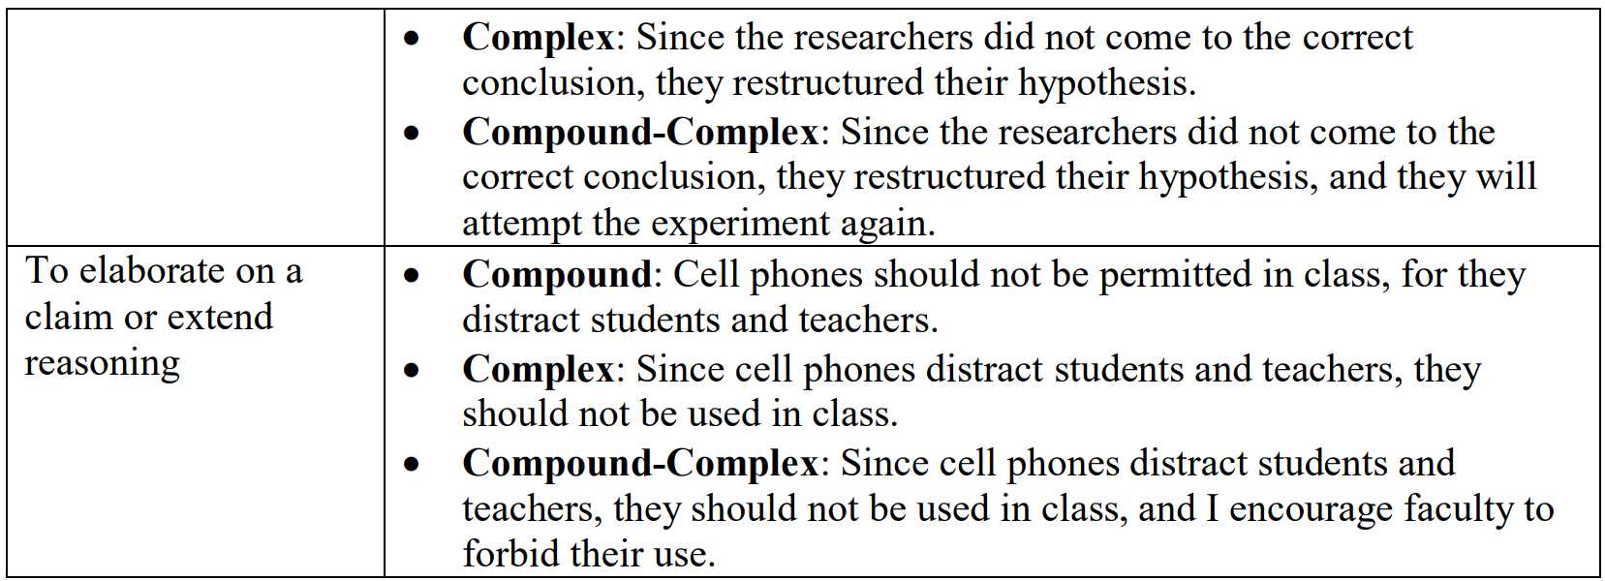

Slide 40
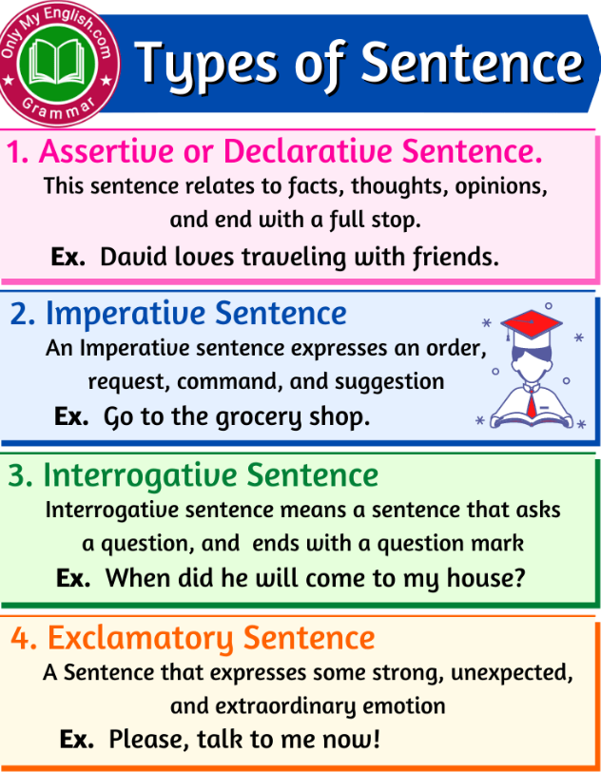

Slide 41
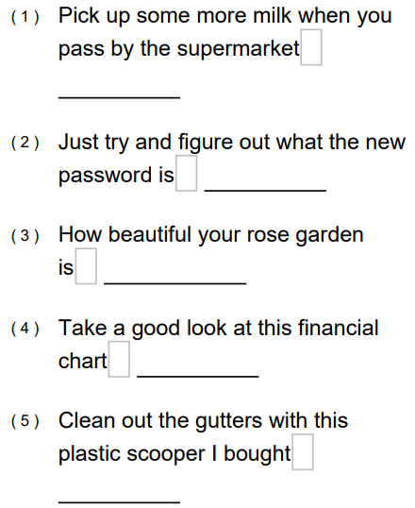
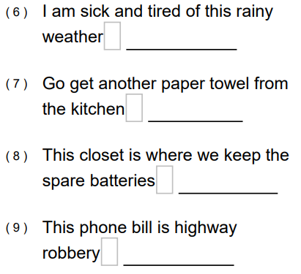
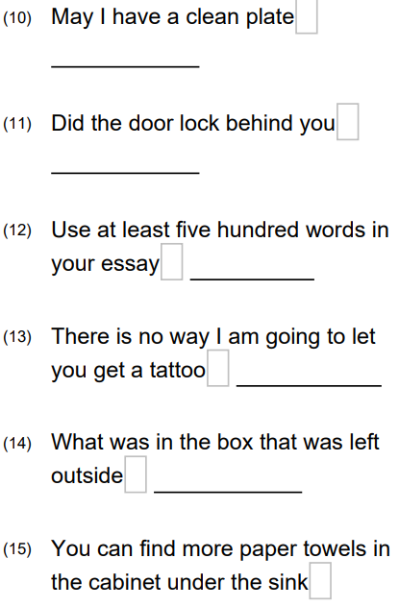
Exercise

Slide 42
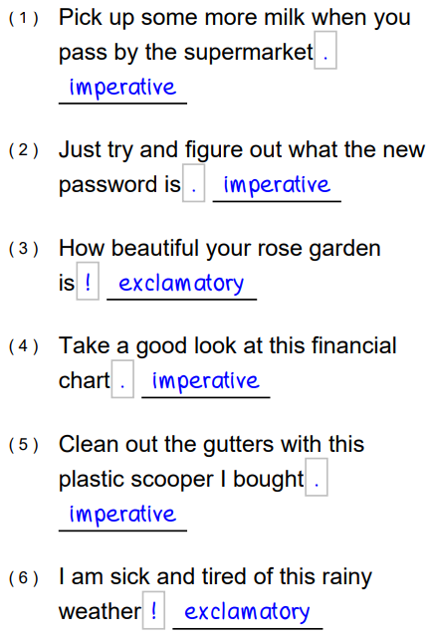
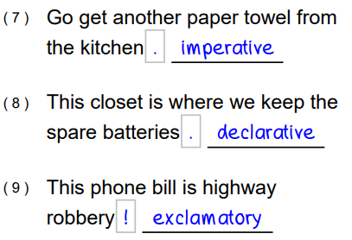
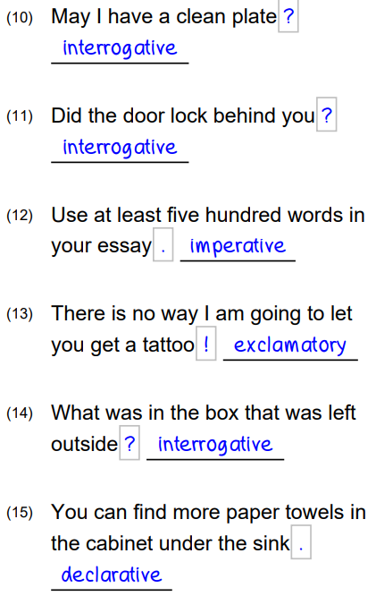

Slide 43
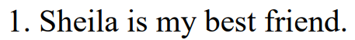
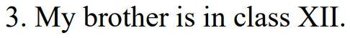

Slide 44
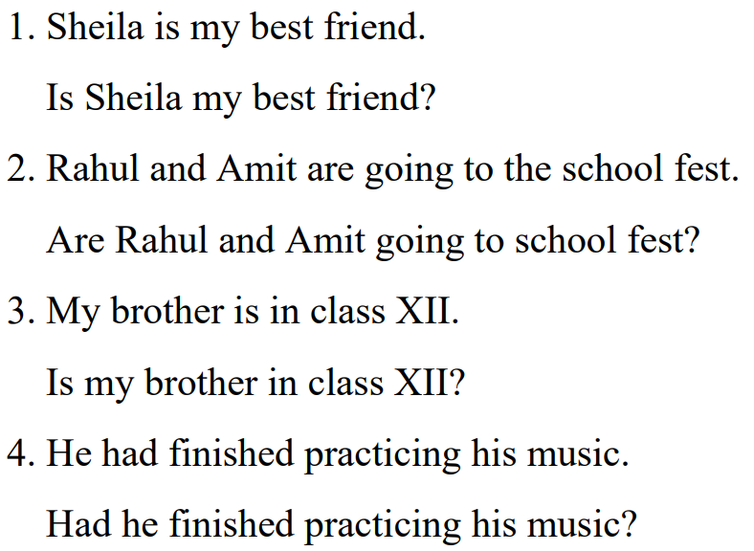

Slide 45
Change the following sentences into negative and interrogative sentences
i) Uman can fly kites
ii) Sagar will help me with this project
iii) Chetan could lift really heavy weights
iv) You could have taken the school bus
v) This will be a difficult assignment
vi) Rehaan may become the next captain

Slide 46
i) Uman can fly kites
Negative sentence– Umang cannot fly kites
Interrogative sentence– Can Umang fly kites?
ii) Sagar will help me with this project
Negative sentence– Sagar will not help me with this project
Interrogative sentence – Will Sagar help me with this project?

Slide 47
iii) Chetan could lift really heavy weights
Negative sentence – Chetan could not lift really heavy weights
Interrogative sentence – Could Chetan lift really heavy weights?
iv) You could have taken the school bus
Negative sentence – You could not have taken the school bus
Interrogative sentence – Could you have taken the school bus?

Slide 48
v) This will be a difficult assignment
Negative sentence – This will not be a difficult assignment
Interrogative sentence– Will this be a difficult assignment?
vi) Rehaan may become the next captain
Negative sentence– Rehaan may not become the next captain
Interrogative sentence – May Rehaan become the next captain?

Slide 50
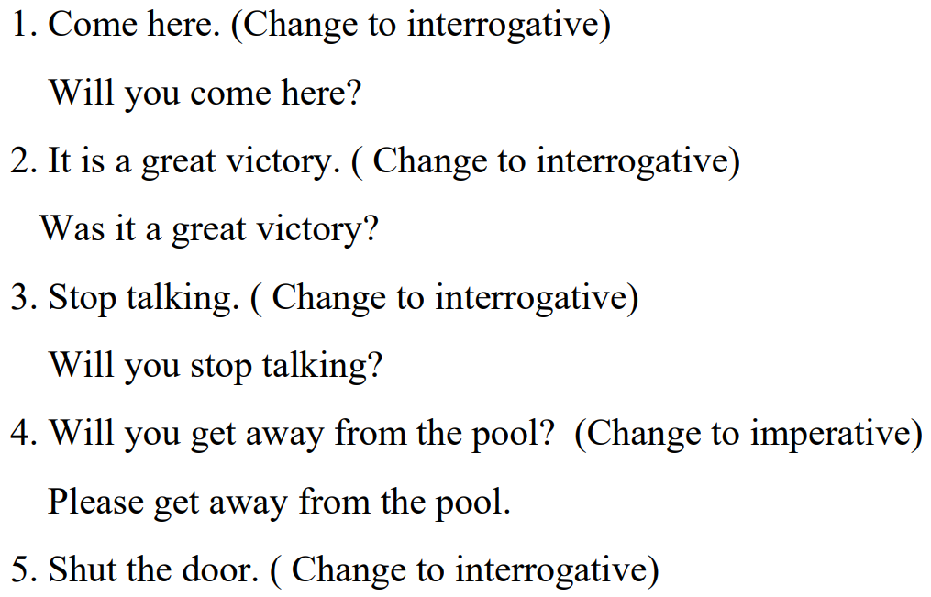
Find the error
Is it a great Victory?

Slide 51
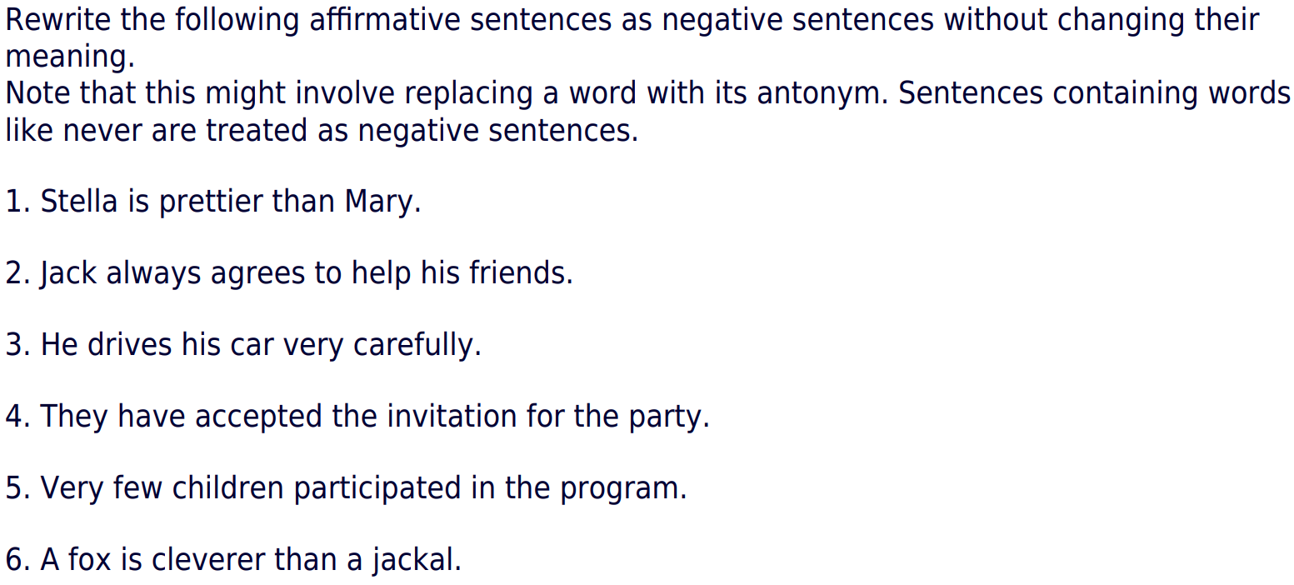
Exercise

Slide 52


Slide 53


Slide 54



